Slide 1
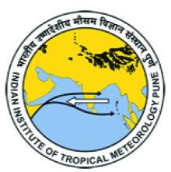

ICRC-CORDEX-2023, IITM, Pune, 25-29 Sep 2023
High-resolution global modelling for regional climate studies
Sabin TP
Centre for Climate Change Research, Indian Institute of Tropical Meteorology
Email: sabin@tropmet.res.in

Slide 2
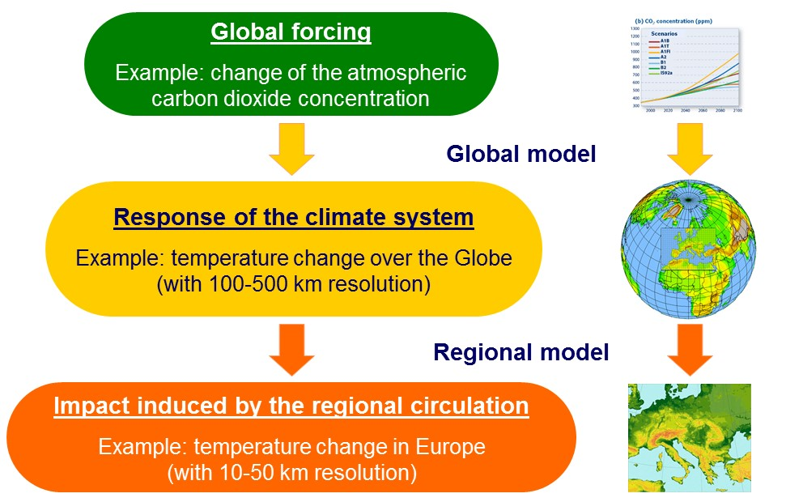

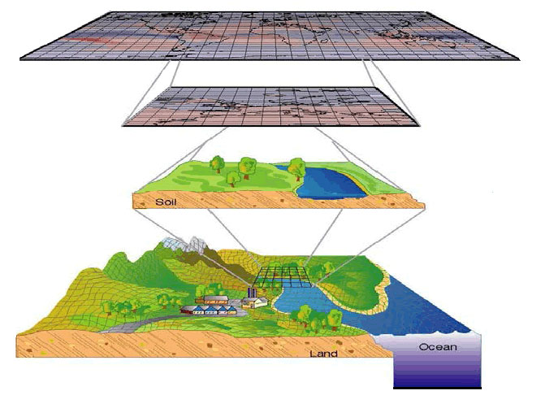
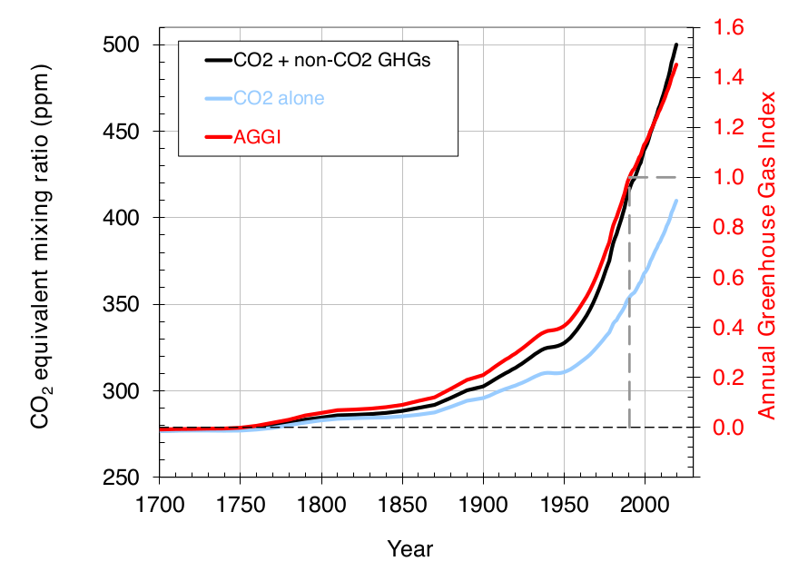
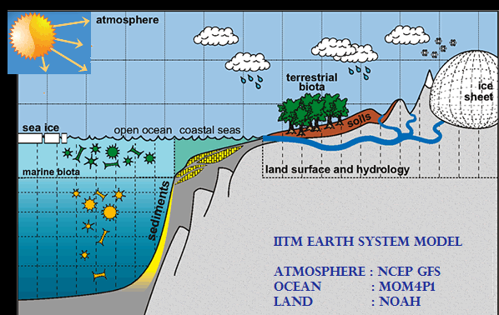
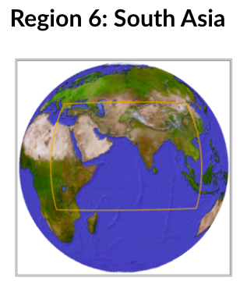
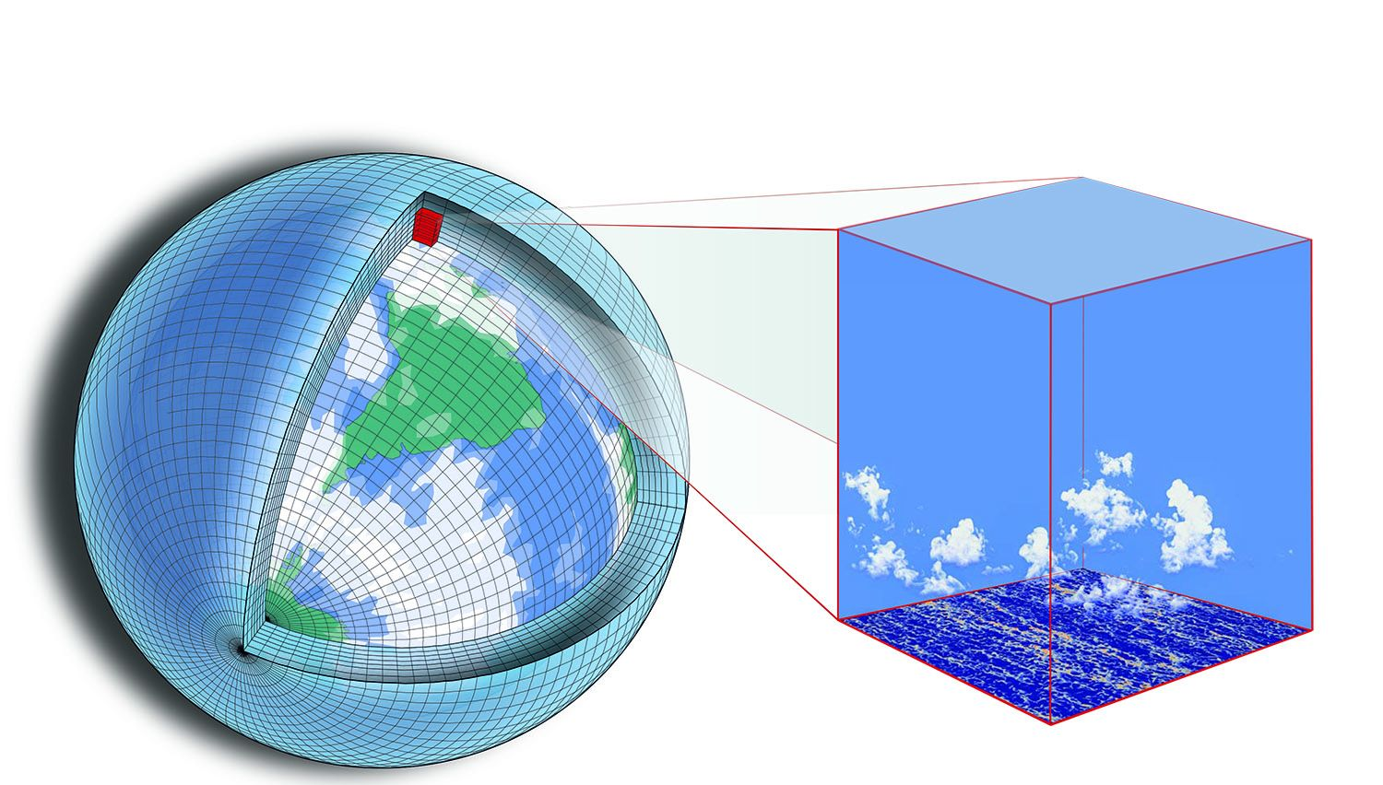

A different approach
Regional downscaling & our alternative approach
Regional Downscaling
Global model
High-resolution global Atmospheric model
Global forcing's:
CO2/Aerosols/LULC
IITM-ESM with T62
Global climate information
(in a 27km horizontal resolution)
High-resolution global Atmospheric model
Which will be used for regional studies
T574 ~ 27km

Slide 3
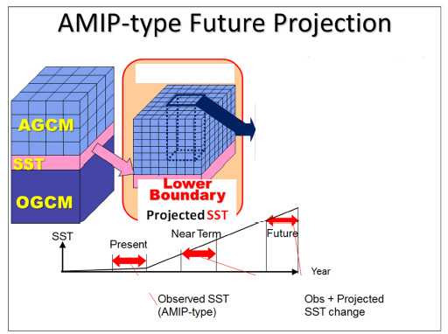
T574 simulation
High resolution IITM-ESM AGCM (T574, ~27 Km)
Dynamical downscaling of IITM-ESM v2 CMIP6 historical simulation using the high-resolution (27 km grid) atmospheric component of IITM-ESM v2
Spectral model with reasonable good skill in simulating Indian and Pacific oceanic teleconnections with Indian monsoon
This high-resolution climate simulation will be able to contribute towards various assessments for the country, along with contributing to CORDEX South Asia.
Global & regional climate assessments
Assessment of south Asian monsoon
27 km AGCM
1995 ~ 2014 2021 ~ 2040 2081 ~ 2100

Slide 4
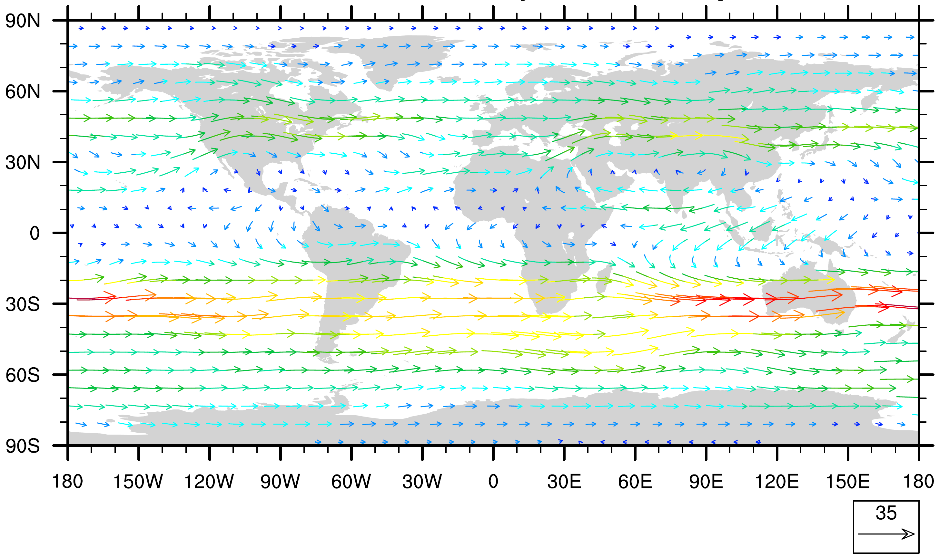
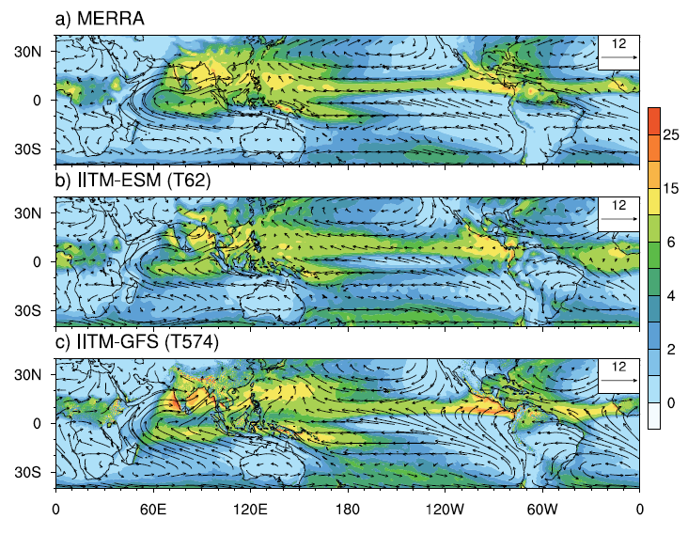
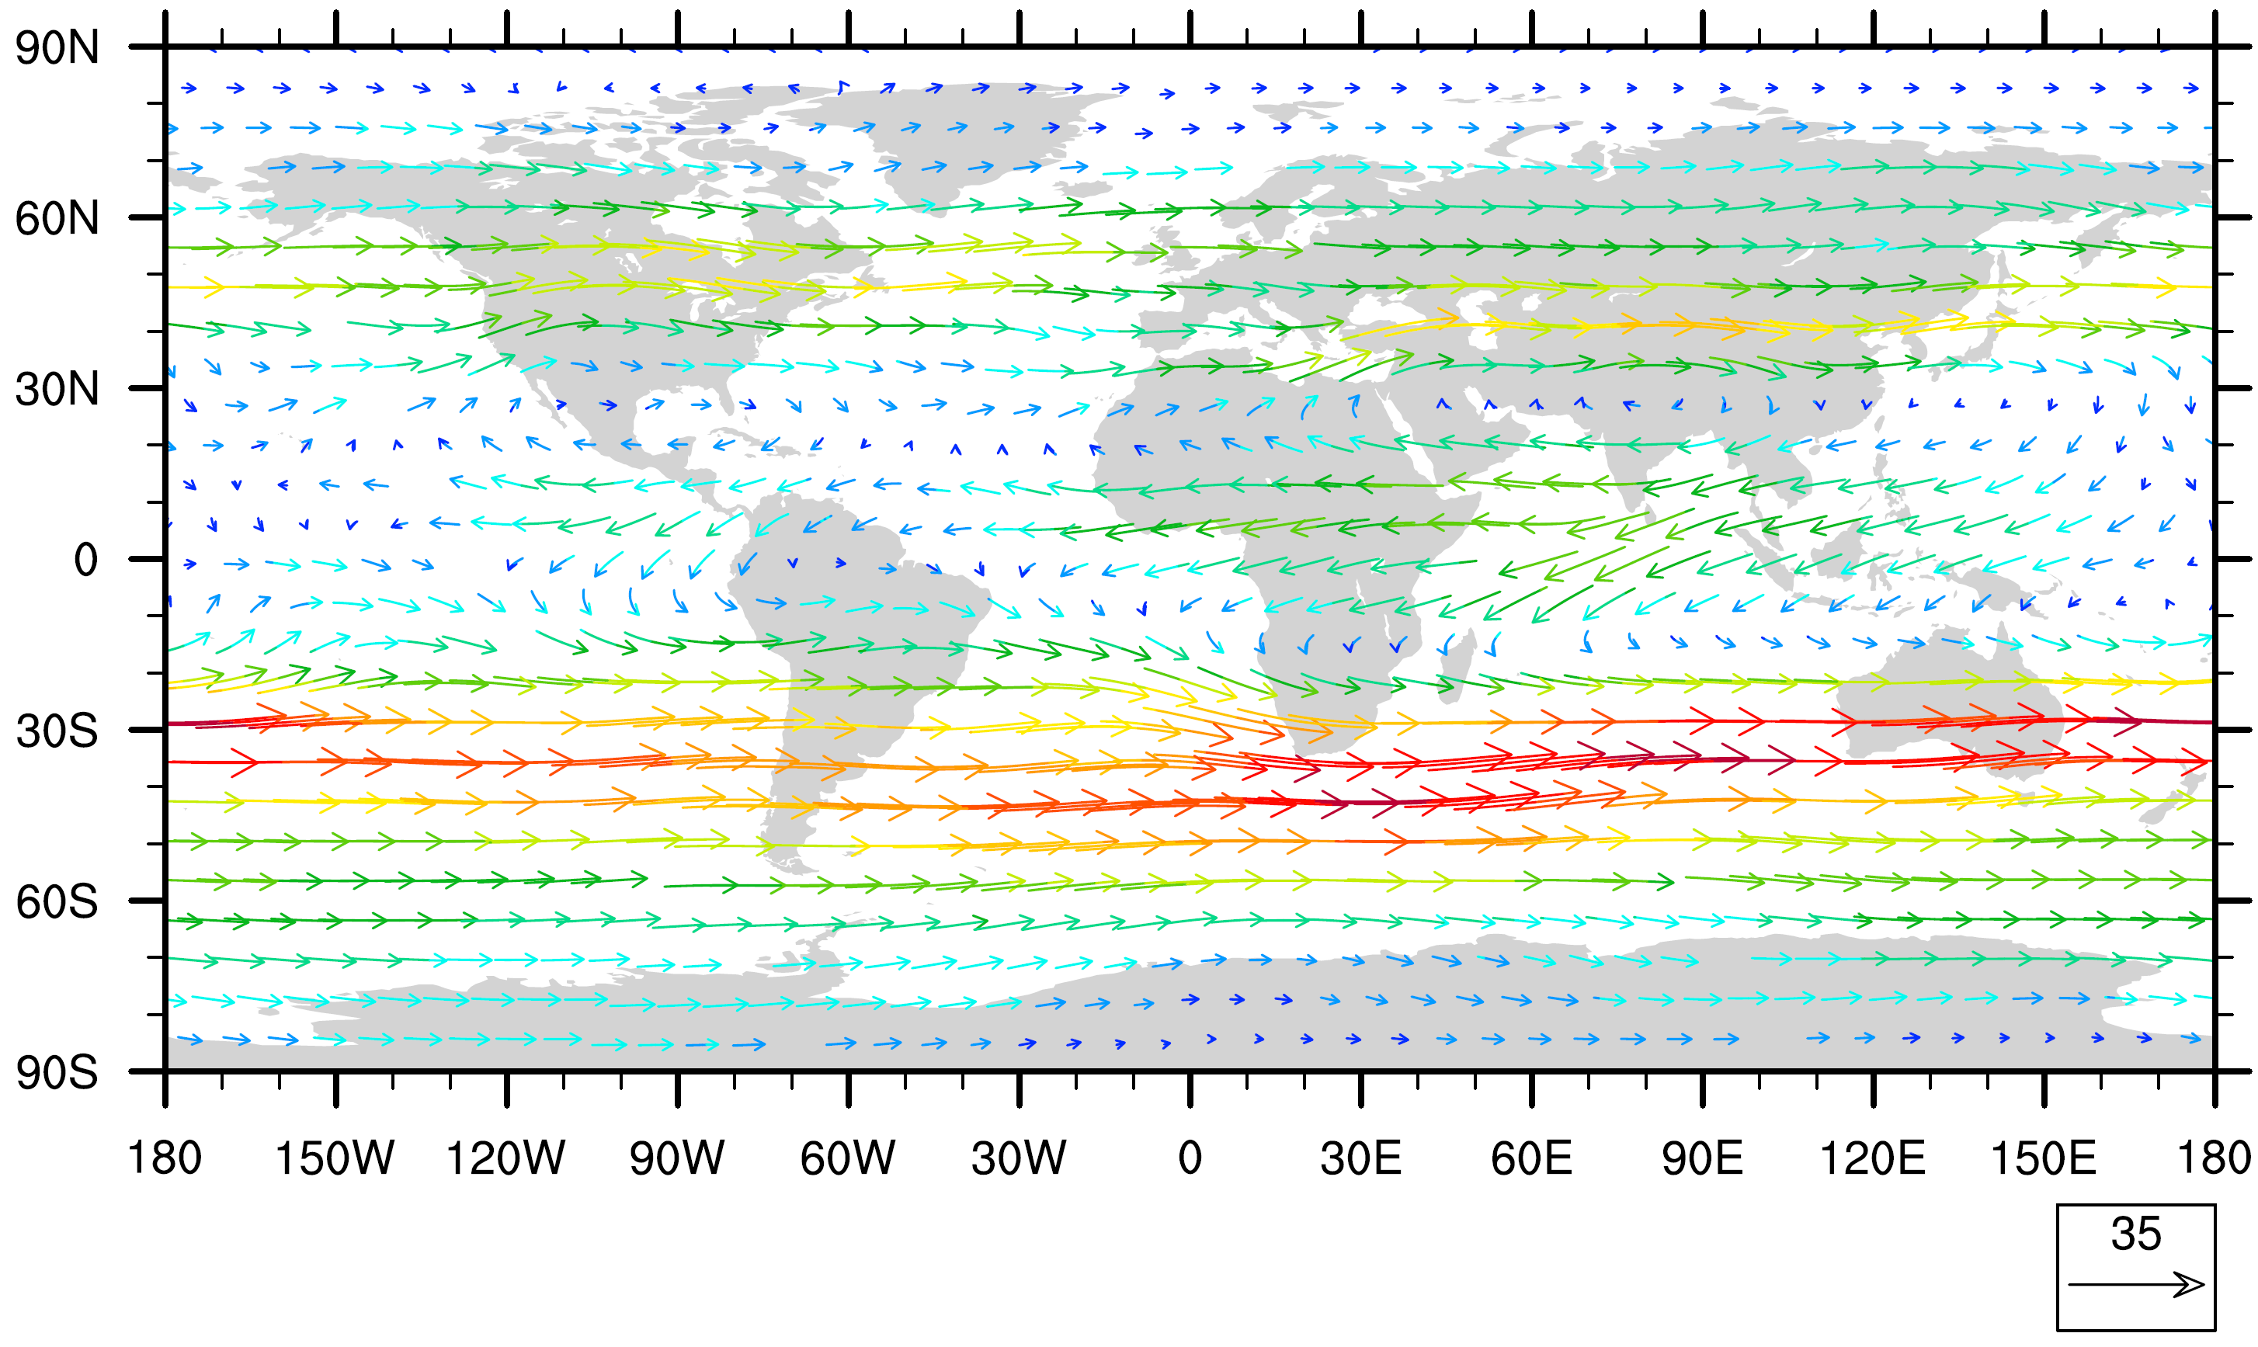

How the simulated global fields
T574, ~27 Km- global precipitation & large scale circulation
Precipitation and low level circulation
Upper Level Circulation (200hPa)
T62
T574

Slide 5
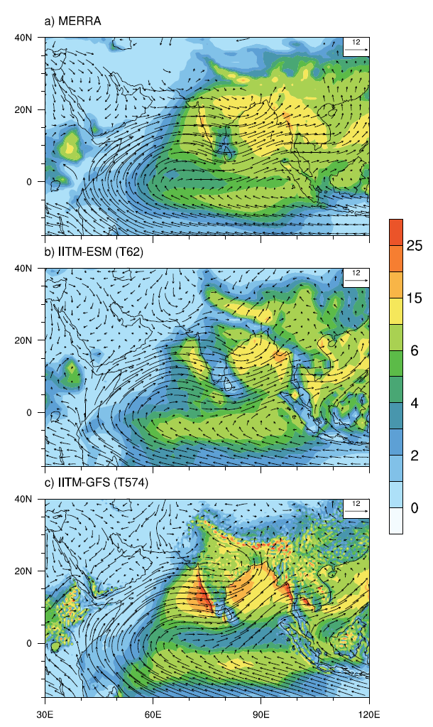
Regional information's
T574, ~27 Km simulation for regional studies
JJAS Mean Precipitation
Clear improvement is visible in the simulated precipitation pattern in the high-resolution model
Narrow orographic precipitation over the western Ghats and precipitation over the monsoon trough is significantly improved in the 27km version
Annual cycle of precipitation
Dry bias is reduced over central India, & orographic precipitation is improved

Slide 6
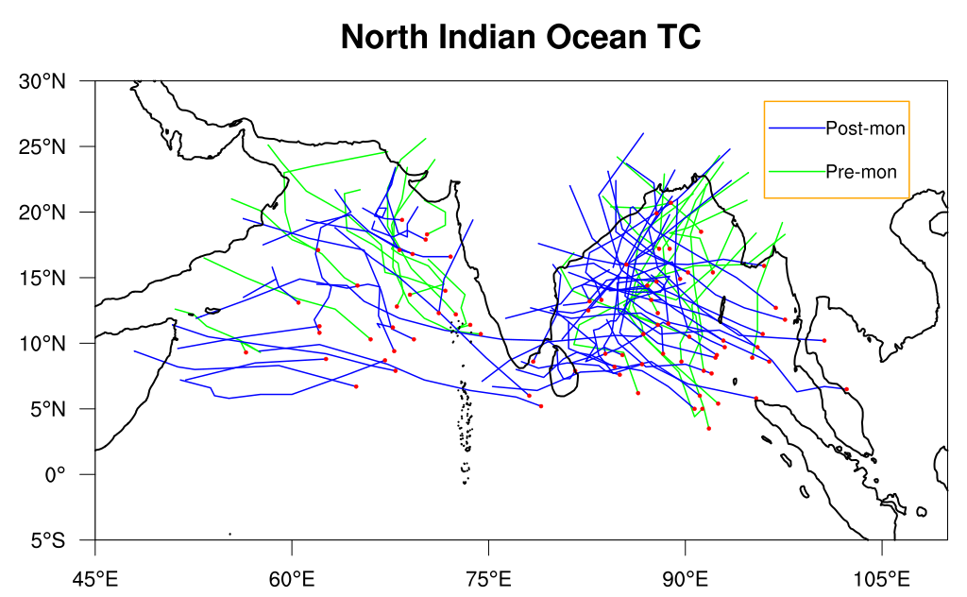
Variabilities
T574, ~27 Km simulation variabilities and features
Inter-annual variability of Indian summer monsoon
North Indian ocean Tropical cyclones
Model is able to capture the annual fluctuations of Indian summer monsoon reasonably well
27 km model is able to capture the NIO - TC’s
This simulation will be used to make a critical assessment of present and future climate change signals over the Indian region

Slide 7
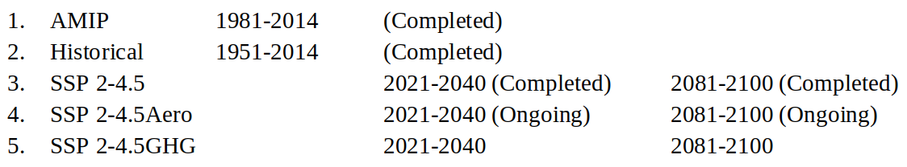
Simulations planned
High resolution IITM- T574 experiments
The following experiments are completed or underway as part of this programme

Slide 8
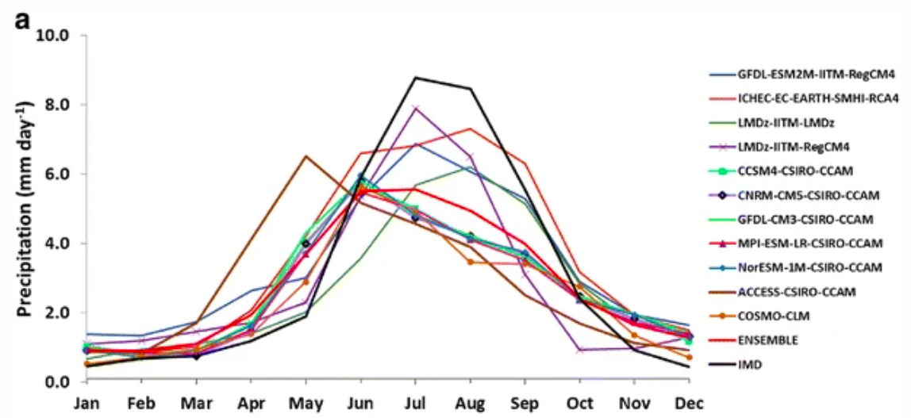
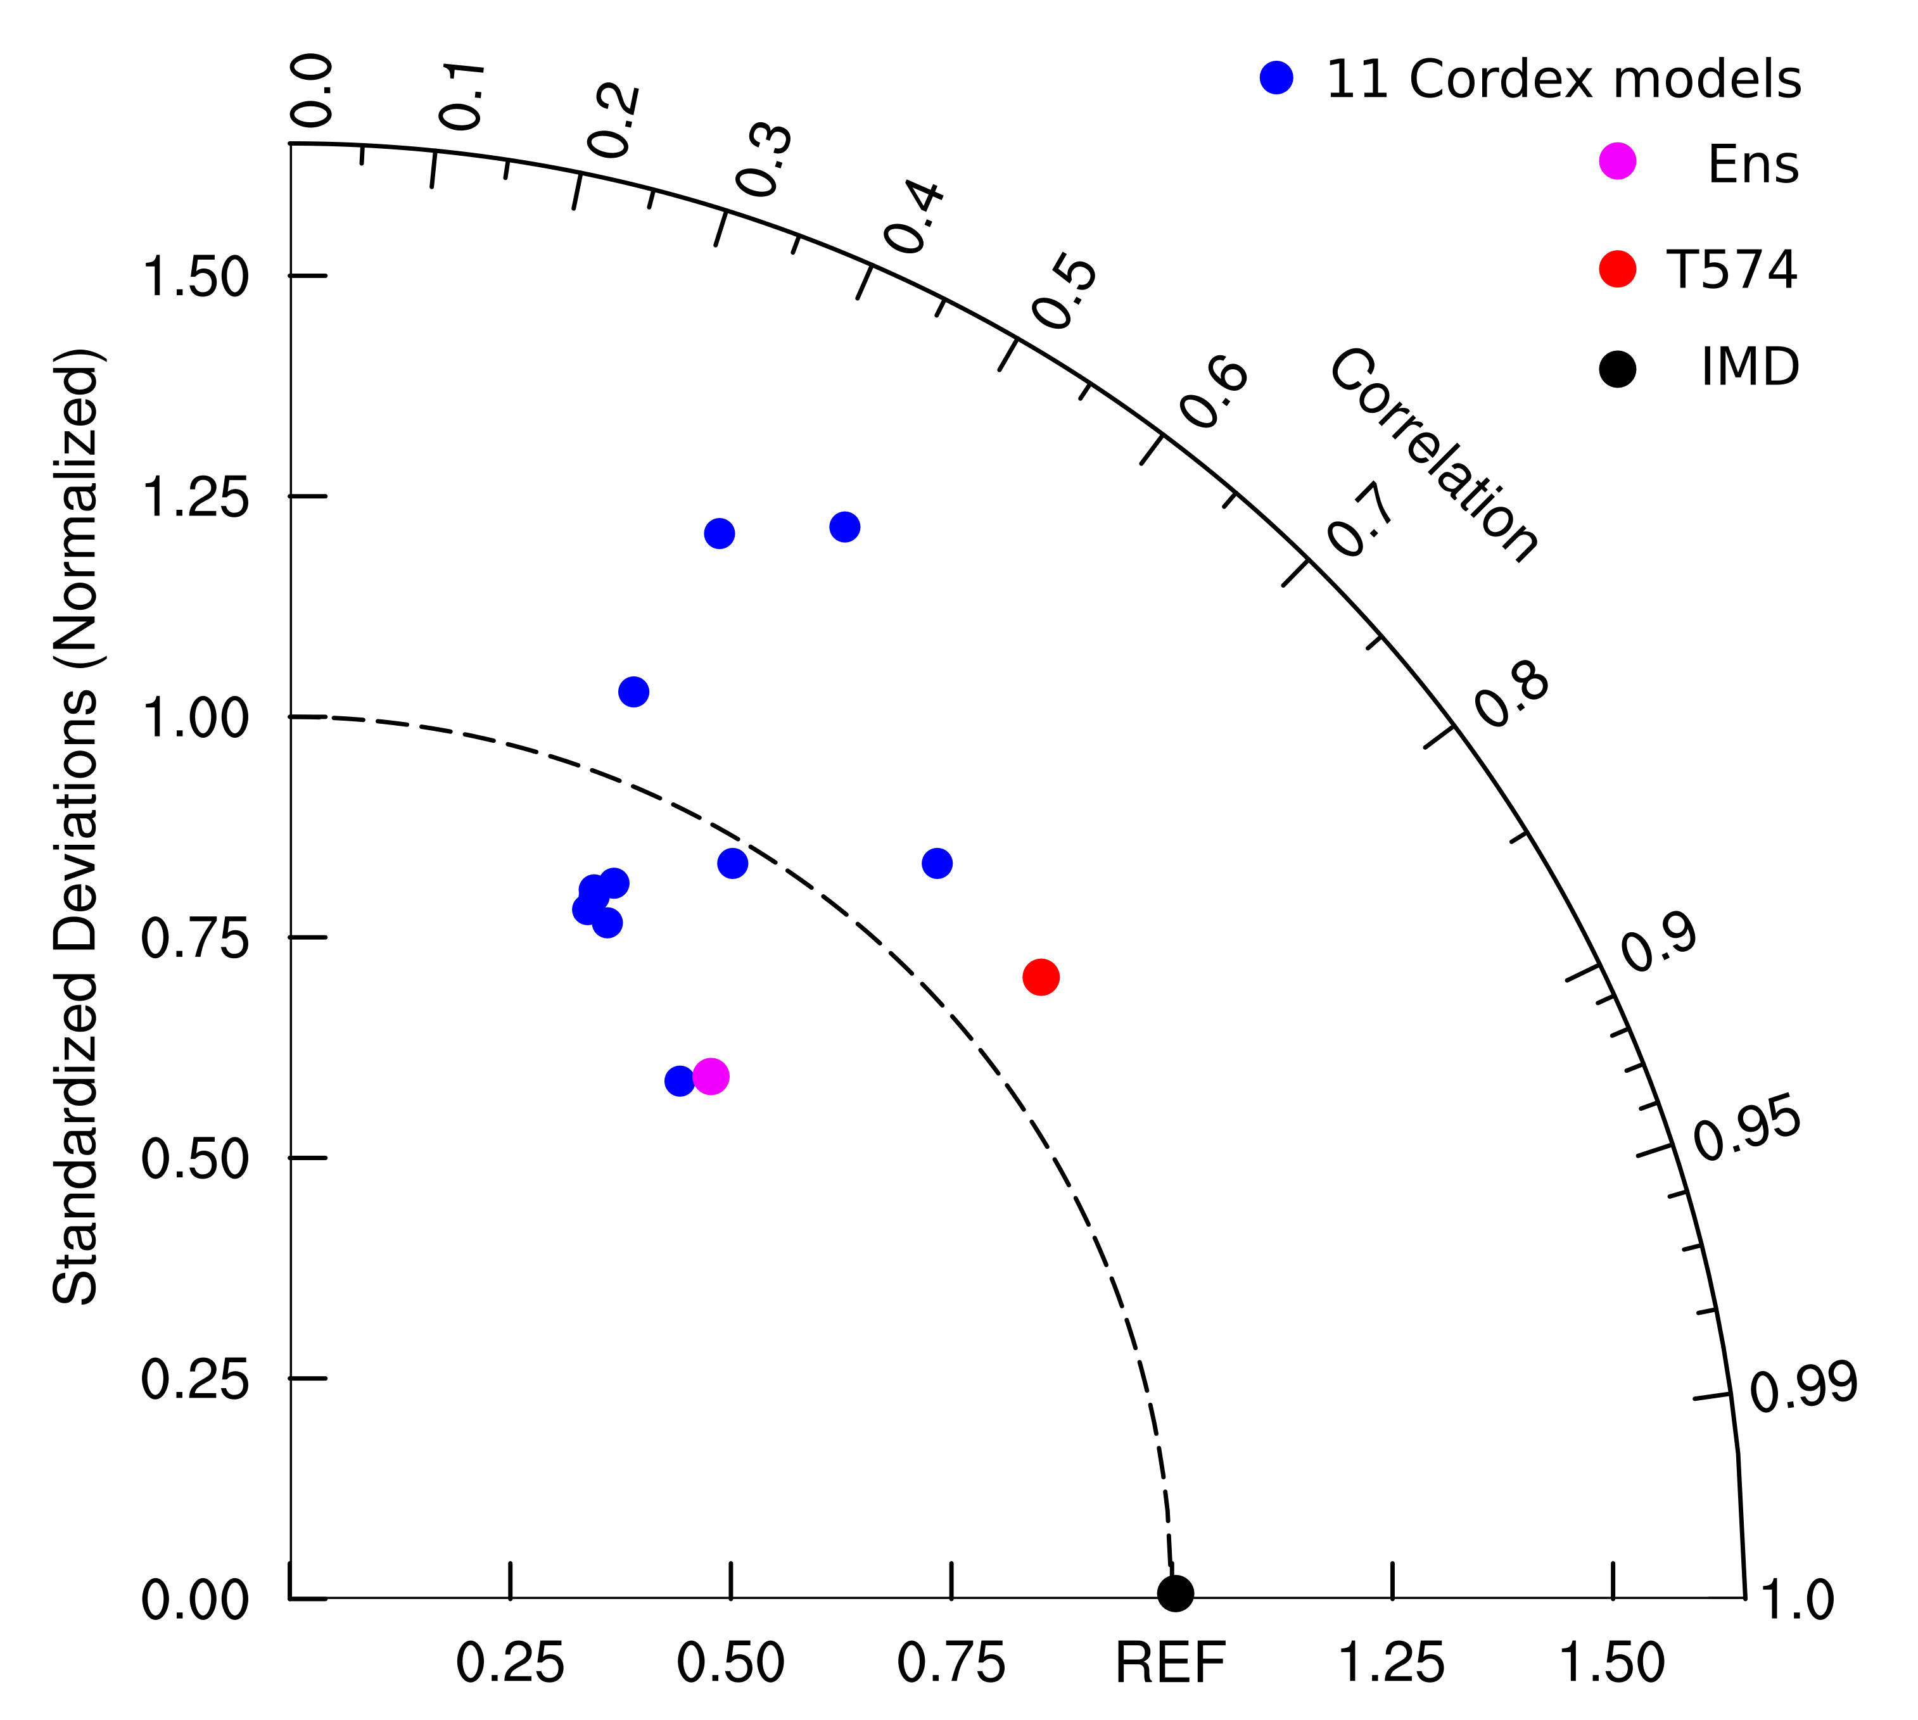
Simulations planned
T574, ~27 Km simulation; mean features
Annual cycle of precipitation; comparison with CORDEX models
Taylor diagram; JJAS precipitation
Choudhary et al 2017

Slide 9
The summary
Summary
The 27km IITM high-resolution model shows significant improvement in simulating the mean and variabilities of monsoon climate.
The model is capable of capturing the tropical cyclone over the north Indian Ocean during the pre-monsoon and post-monsoon seasons.
The 27km global IITM-high resolution model outputs will soon be available for researchers and sectorial studies in the CORDEX South Asia domain.

Slide 10

Thank you

