Slide 1
Analysis of CORDEX Evaluation Experiment over South Asia using RegCM5 based
Dynamical Downscaling of ERA5
Sooraj K P¹, Sanjay J¹, Hamza V¹,
Graziano Giuliani², Erika Coppola² and Filippo Giorgi²
¹Centre for Climate Change Research, Indian Institute of Tropical Meteorology, Pune, India
²Abdus Salam International Centre for Theoretical Physics, Trieste, Bologna, Italy

Slide 2
Need for more CORDEX RCM Simulations in South Asia
The recent IPCC sixth assessment report (AR6) on climate change (IPCC 2023) noted that the studies that addressed the added values of dynamical downscaling in South Asia are still limited, owing to fewer RCM runs carried out in the region relative to other CORDEX domains.
These evaluations of the downscaled climate over South Asia region were produced using multiple RCMs driven by few Coupled Model Intercomparison Project Phase 5 (CMIP5) GCMs.
It may be noted that a subset of these CORDEX-South Asia runs contributed by IITM and ICTP were generated using versions of the ICTP RegCM4 RCM.
The CORDEX has recently published an experiment design document, which presents a simulation framework for the dynamical downscaling of global climate projections from the sixth phase of CMIP (CMIP6).
Notes:
As per AR6, the dynamical downscaling studies over South Asia are limited as there are fewer RCM runs over this region compared to the other CORDEX domains. Both IITM and ICTP had earlier contributed to CORDEX South Asia through dynamical downscaling of CMIP5 global climate simulations using versions of ICTP RegCM4. The CORDEX has recently published an experiment design document for dynamical downscaling of CMIP6 projections

Slide 3
ICTP RegCM5 for CORDEX South Asia
The present study provides an overview of the latest version of the ICTP RegCM5 RCM configured in the CORDEX CMIP6 experiment framework for the South Asia region to carry out an evaluation simulation driven by the ERA5 reanalysis for the period 1979 to 2020.
The initial experiments focused on the relatively better seasonal climate simulated by RegcM5 with a tuned up representation of the sub-grid scale deep cumulus convection processes.
The study aims to evaluate the performance of RegCM5 in simulating seasonal climatology of the near-surface air temperature and precipitation by comparing with the ERA5 dataset and other gridded observational estimates.
Notes:
We used here the latest version of the ICTP RCM (Fifth Generation, RegCM5), as configured in the CORDEX CMIP6 experiment framework over the South Asian region. We then did various sensitivity tests to tune RegCM5. The best tuned up version is then used for carrying out the evaluation runs at a spatial resolution of 25 km following the CORDEX CMIP6 protocol, with initial and lateral meteorological boundary conditions provided by the ECMWF-ERA5 reanalysis. 42-year long simulations are done thus covering the period 1979–2020

Slide 4
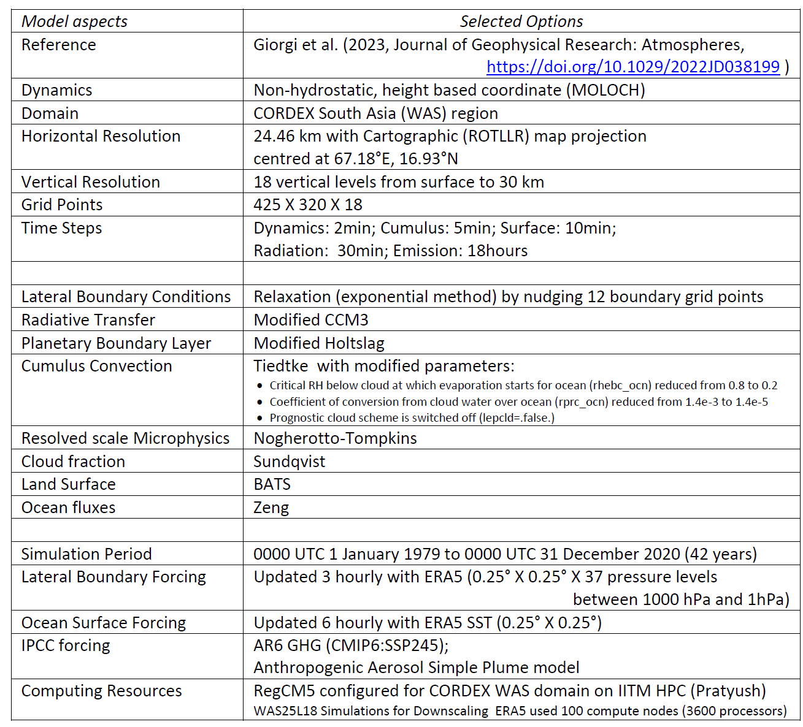
Dynamics and Physics Options used in RegCM5 Evaluation Simulation
for CORDEX South Asia

Slide 5
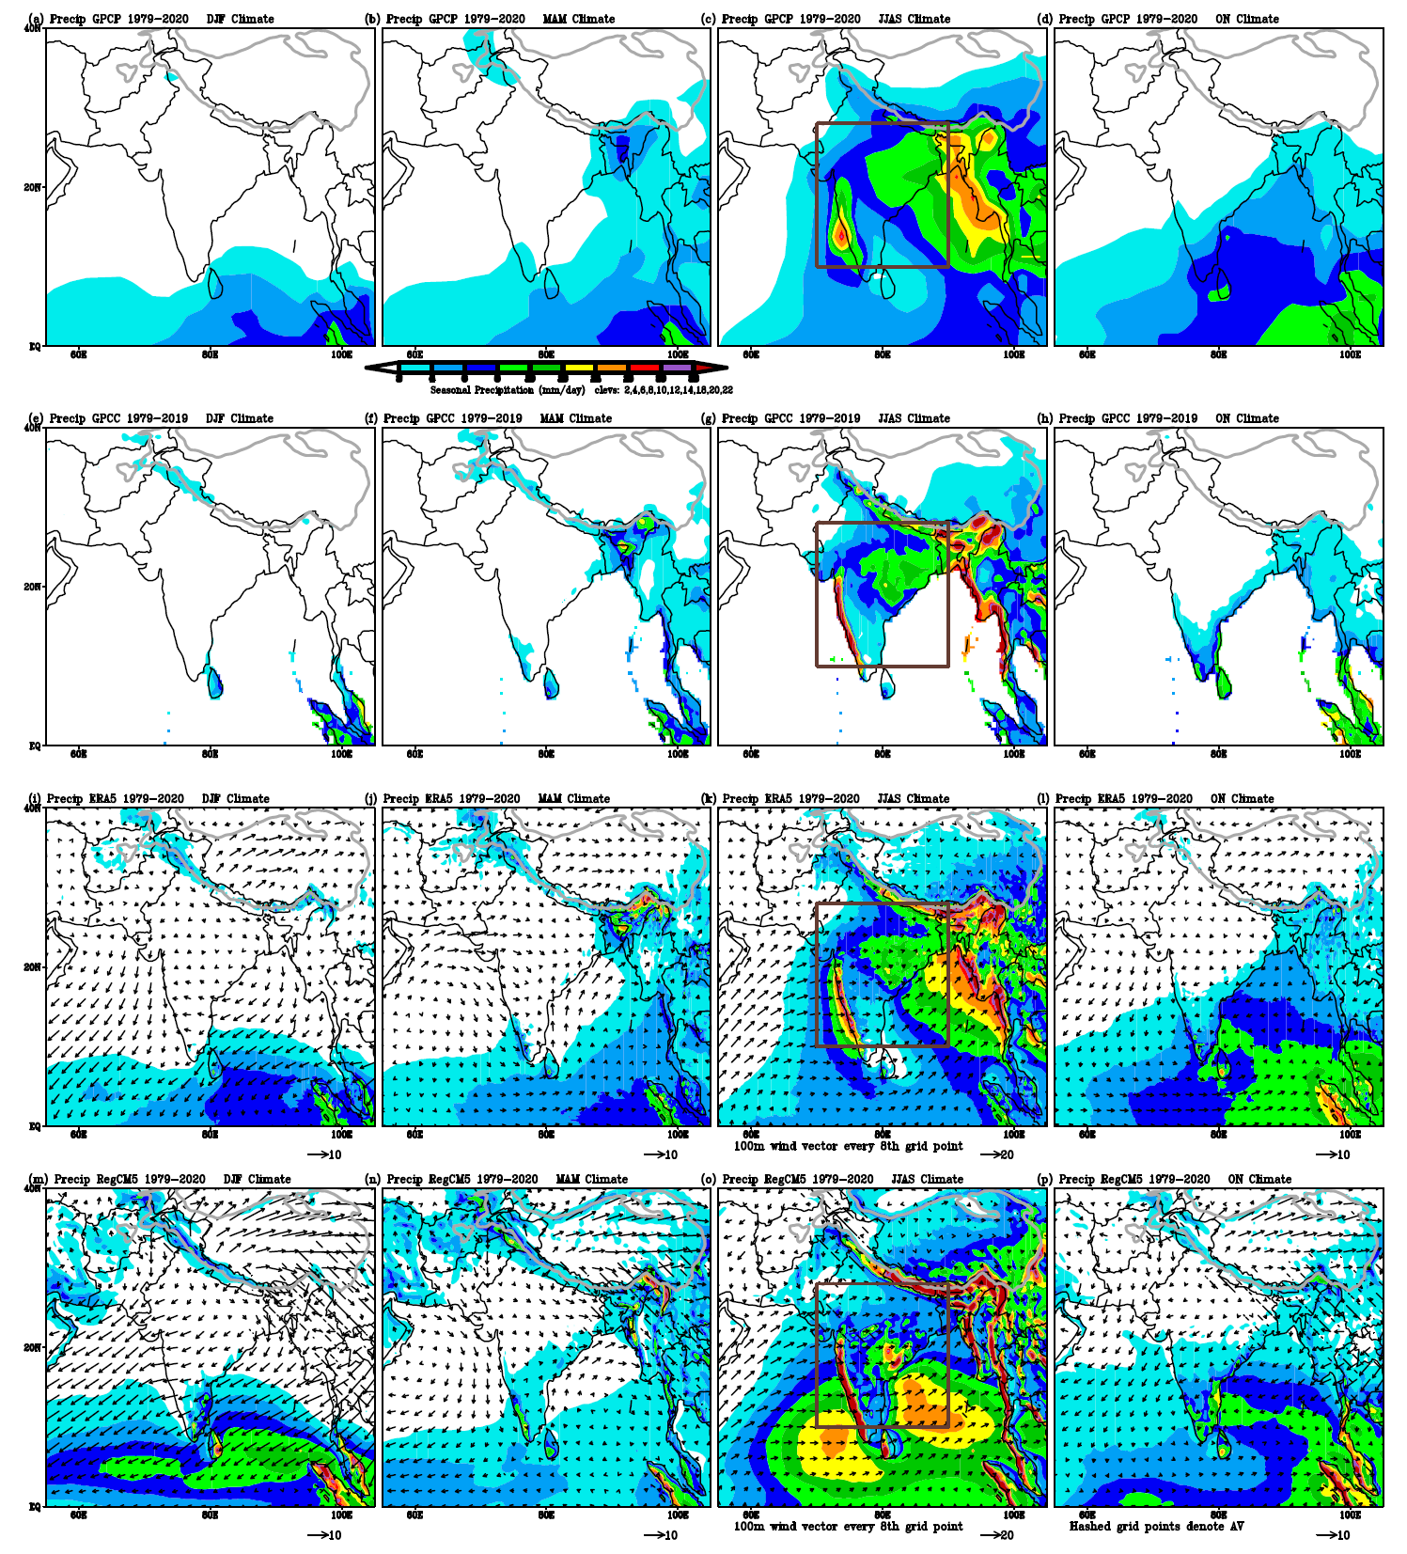
Seasonal Climate (1979-2020) of Precipitation (mm/day; shading) and
100 m Wind (m/sec; vectors)
Winter Pre-Monsoon Summer Monsoon Post-Monsoon
RegCM5 based Dynamical Downscaling of ERA5 in the CORDEX Evaluation Experiment Framework over South Asia Region
GPCP
1979-2020
GPCC
1979-2019
Captured the seasonal transition in wind and rainfall over Indian and surrounding regions.
ERA5
1979-2020
RegCM5
1979-2020

Slide 6
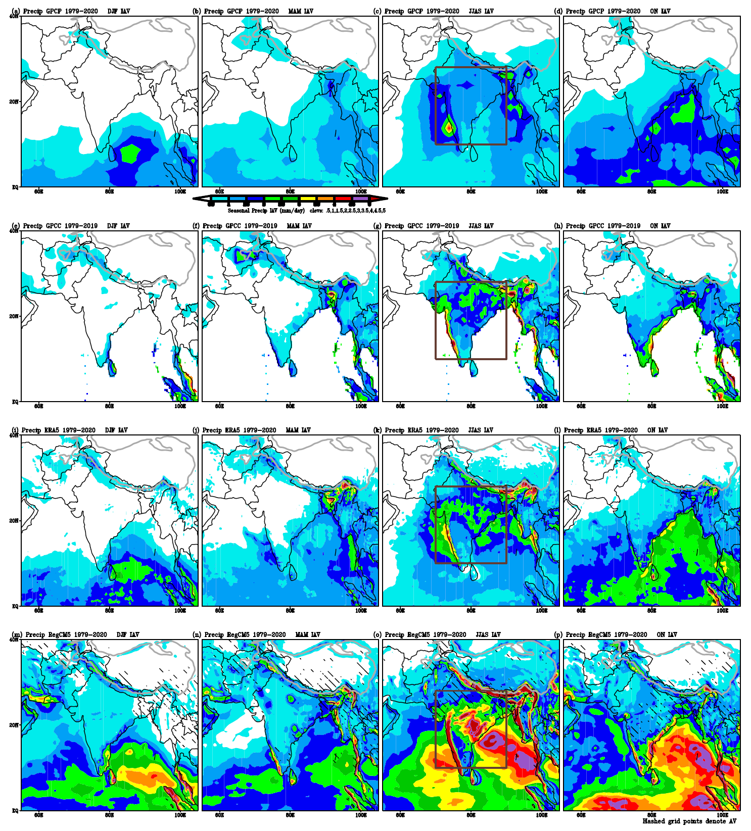
Seasonal Interannual Variability (1979-2020) of Precipitation (mm/day; shading)
Winter Pre-Monsoon Summer Monsoon Post-Monsoon
RegCM5 based Dynamical Downscaling of ERA5 in the CORDEX Evaluation Experiment Framework over South Asia Region
GPCP
1979-2020
GPCC
1979-2019
ERA5
1979-2020
RegCM5
1979-2020

Slide 7
Concluding Remarks
Overall, the RegCM5 produces a good representation of Indian climate characteristics.
The simulated climatology of rainfall over South Asia is sensitive to the representation of the physical process in the model, particularly to the deep cumulus parameterization schemes used.
Currently we are carrying out model physics sensitivity simulations for further improving the spatial and temporal characteristics of South Asian monsoon climate.
We hope to finalize soon a suitable configuration set-up of RegCM5 RCM for the CORDEX dynamical downscaling simulation framework of global climate from the CMIP6 historical simulations and the CMIP6 ScenarioMIP future projections.

Slide 8
Thanks for your attention
Email: sooraj@tropmet.res.in
Thank You
  ICRC-CORDEX 2023 Organizers
  ICTP Italy
  IITM HPC Support
  MoES GoI
  Director IITM

